Slide 1
Machine Learning A-Z™: Hands-On Python & R In Data Science
Clustering: K-Means and Hierarchical
June 28, 2019
Ariel Capetillo
Juan Carlos Urrutia

Slide 2
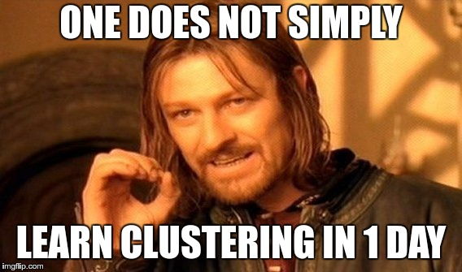
Contents
01 |  | Introduction to Clustering
02 |  | K-Means Clustering
03 |  | K-Means in Python
04 |  | K-Means in R
05 |  | Quiz: K-Means
06 |  | Hierarchical Clustering (HC)
07 |  | HC in Python
08 |  | HC in R
09 |  | Quiz: HC
Notes:
Ask: Who watched this week videos?

Slide 3
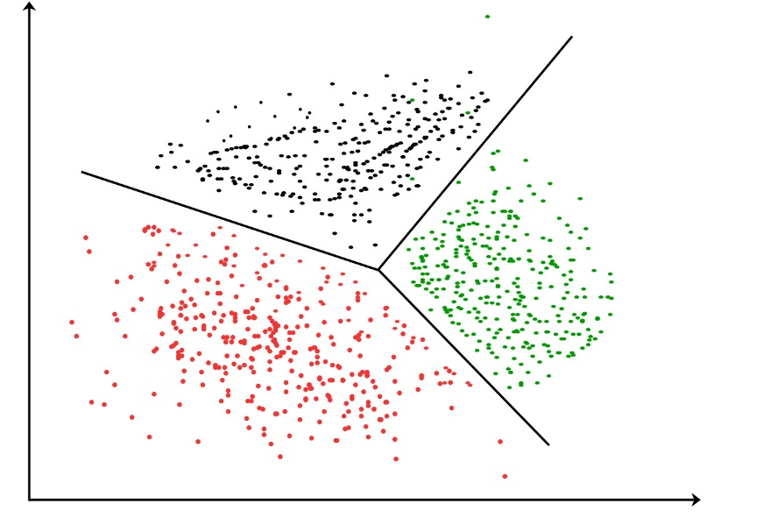
Clustering
Similar to Classification, but with a different basis
In Clustering: What are you looking for?
Today, we will be talking about:
-K-Means
-Hierarchical Clustering

Slide 4
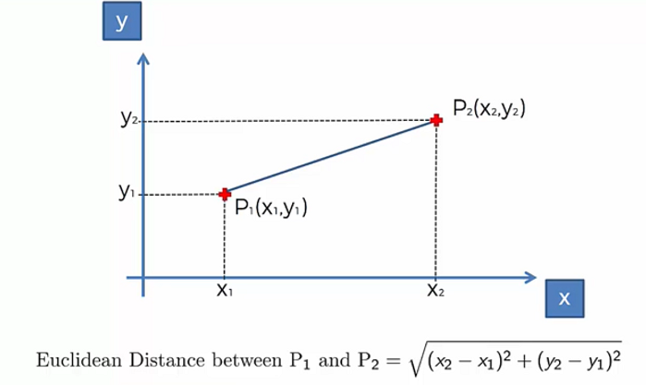
Euclidian Distance

Slide 5

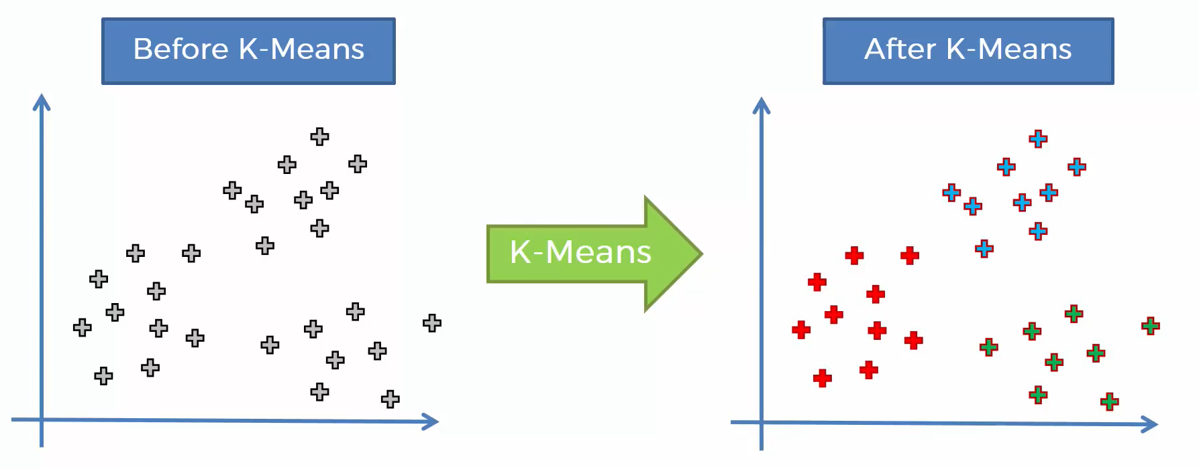
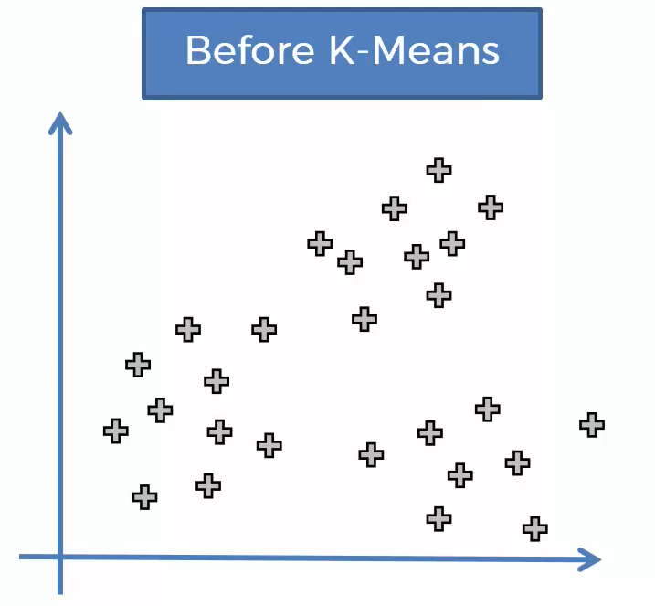
K-Means

Slide 6
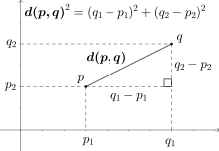
K-Means
How the algorithm works
1
Choose the number K of clusters
Let’s cover this interactively on the Whiteboard
2
Select at random K points, the centroids
3
Assign each data point to the closest centroid (forming K clusters)
4
Compute a place a new centroid for each cluster
5
Reassign each data point to the new closest centroid and go to step 4 (if there is not a reassignment, finish the process)

Slide 7
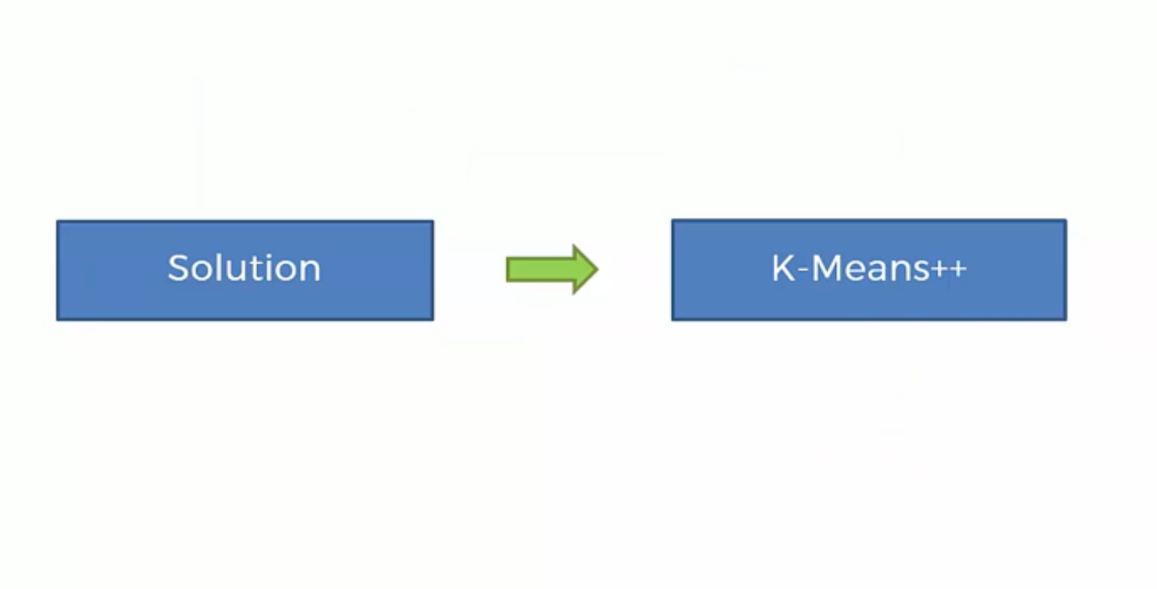
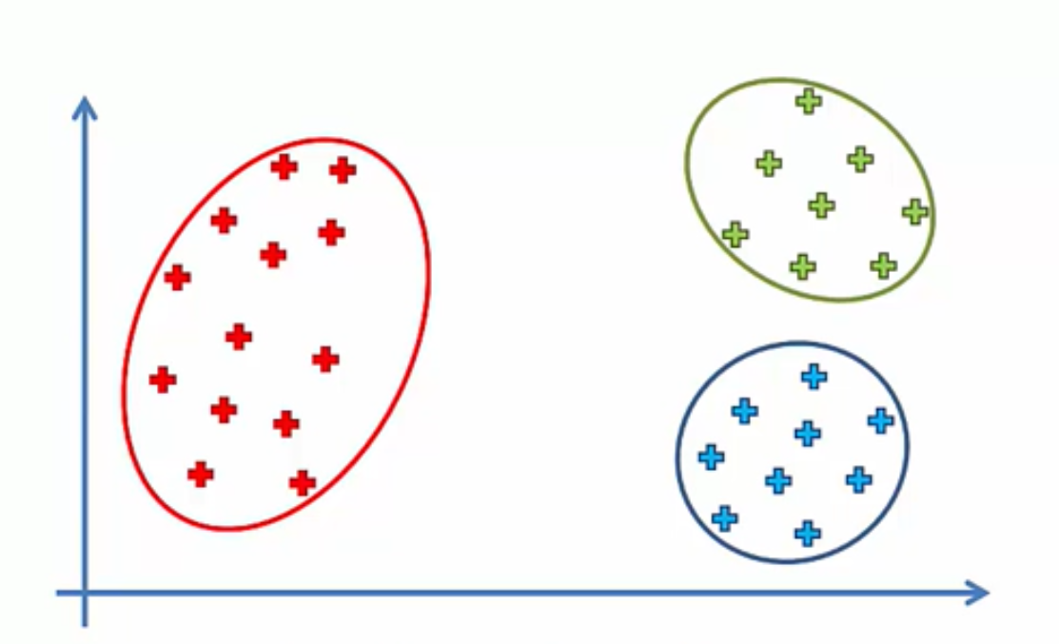
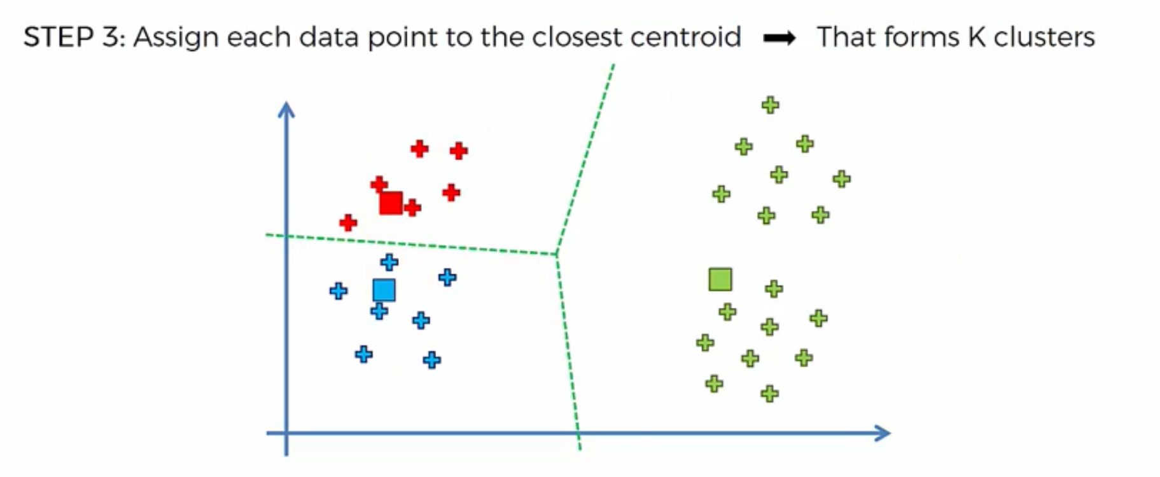
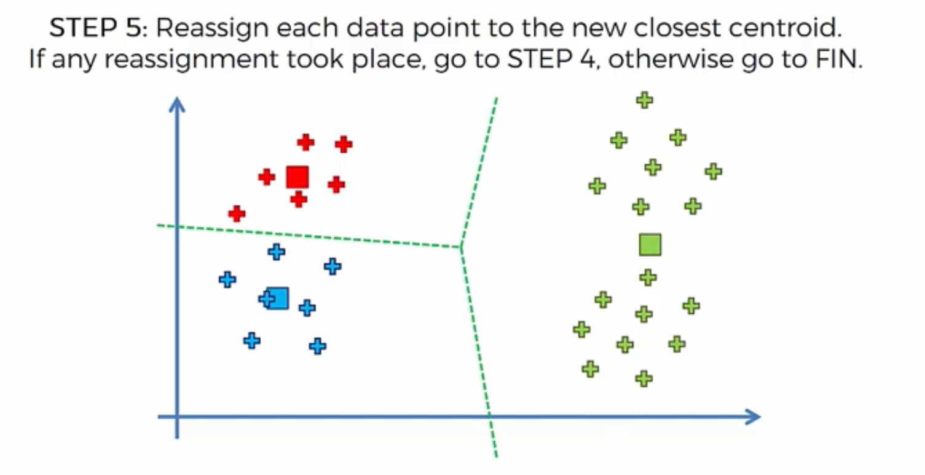
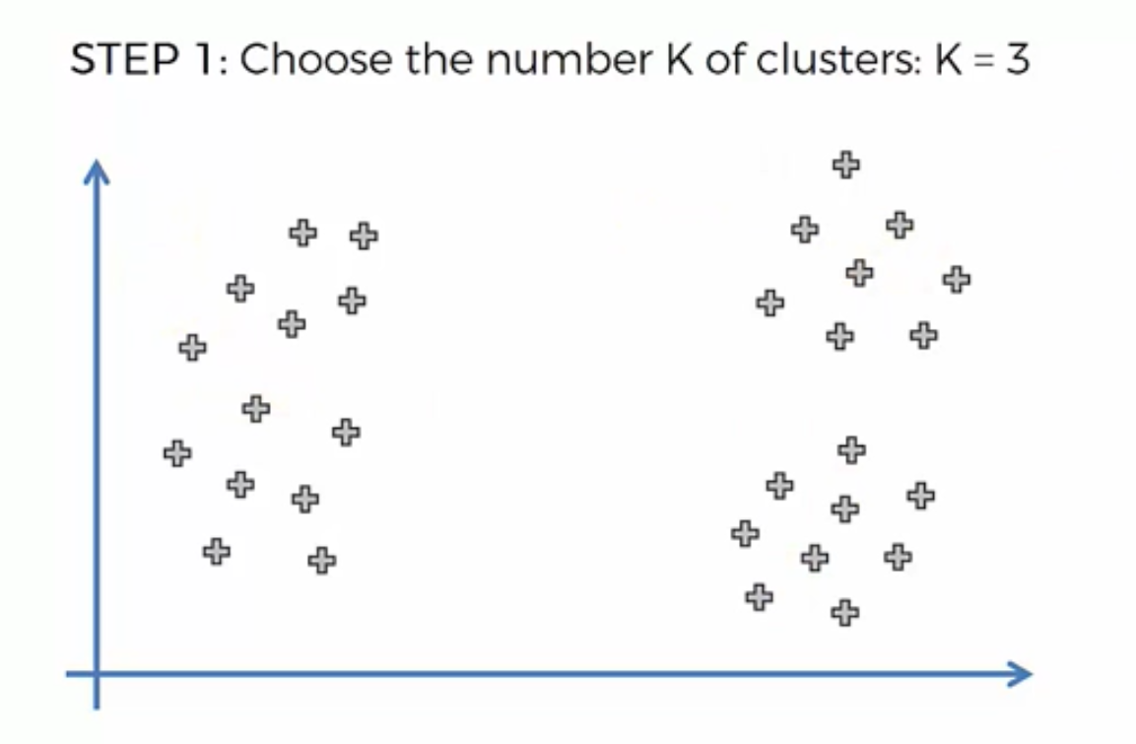
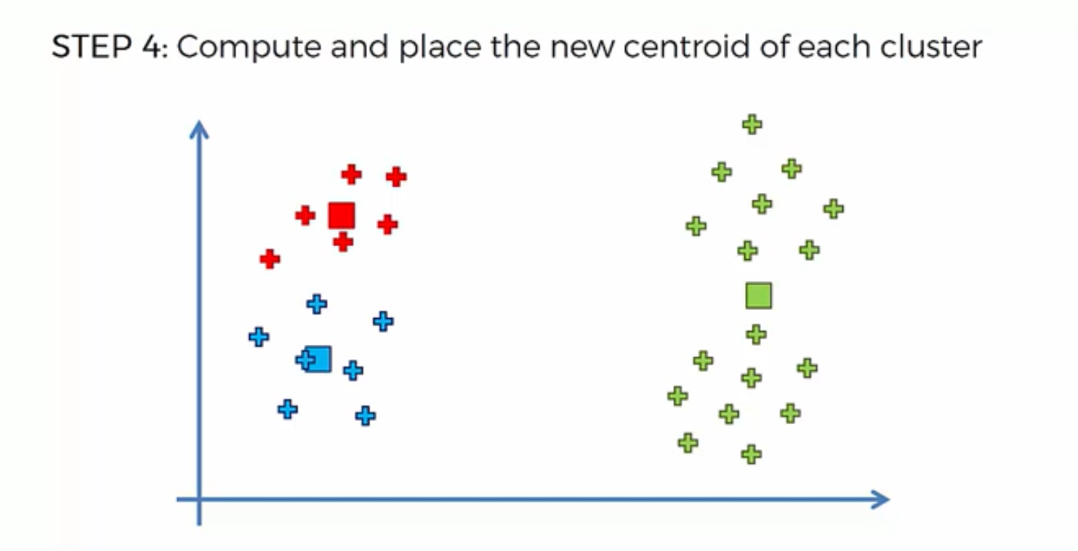
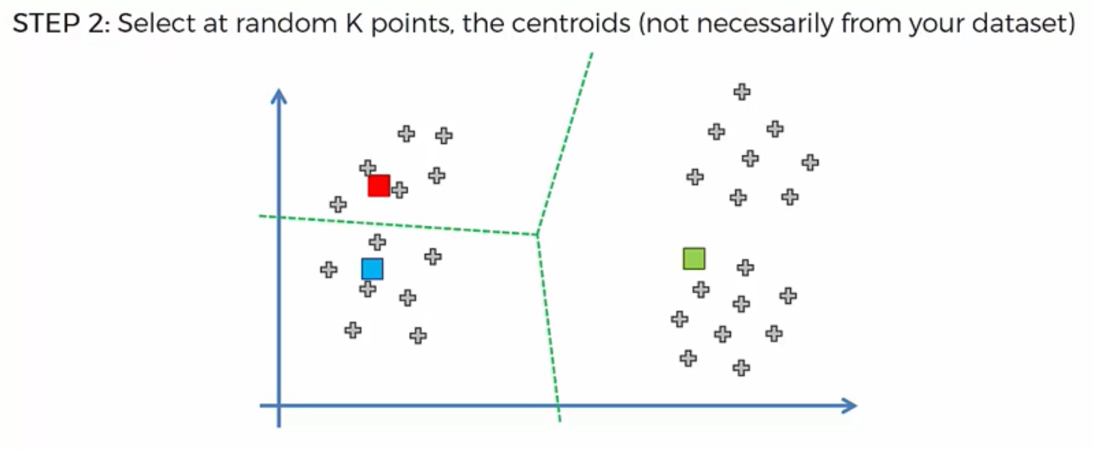
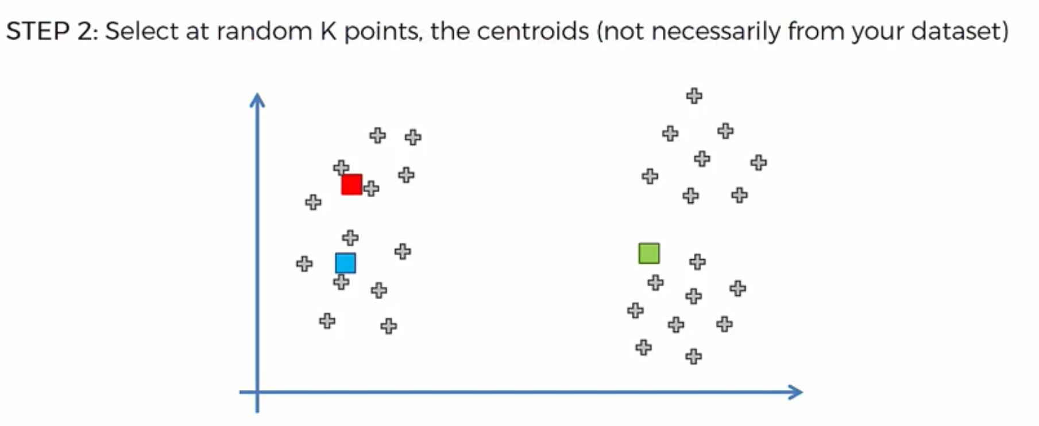
Random Initialization Trap
Now, for the same case, we will start from 0, but selecting bad random initial centroids
Supose we finished with the following three clusters

Slide 8
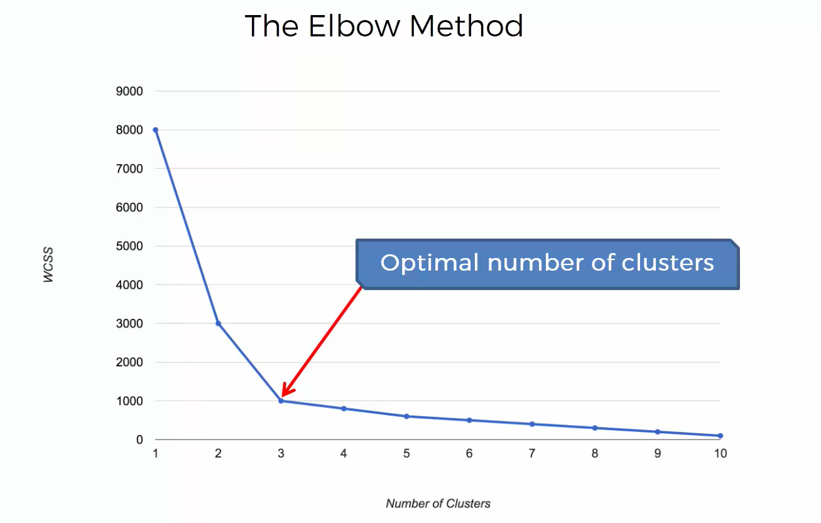
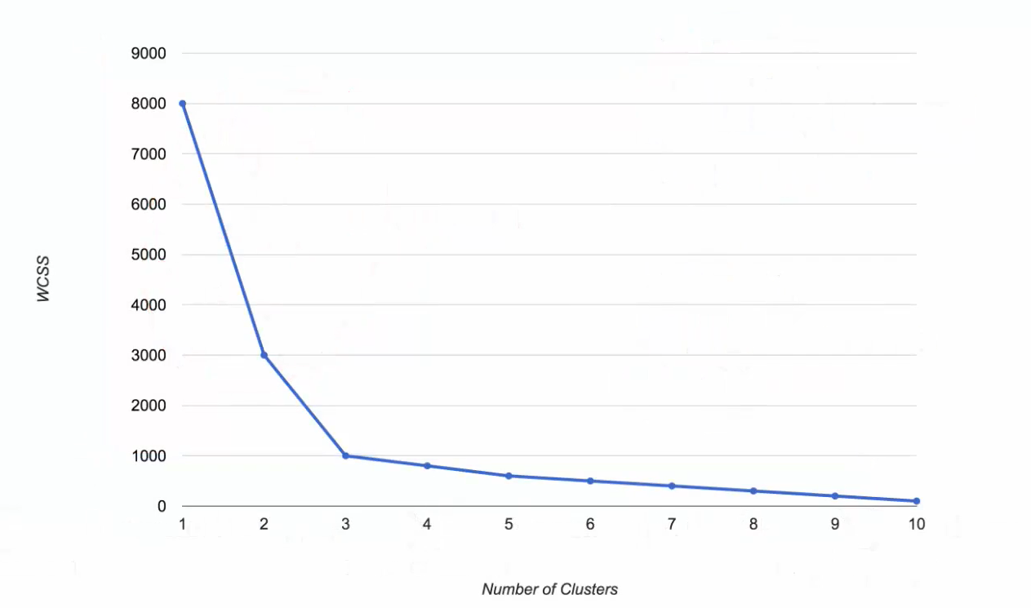
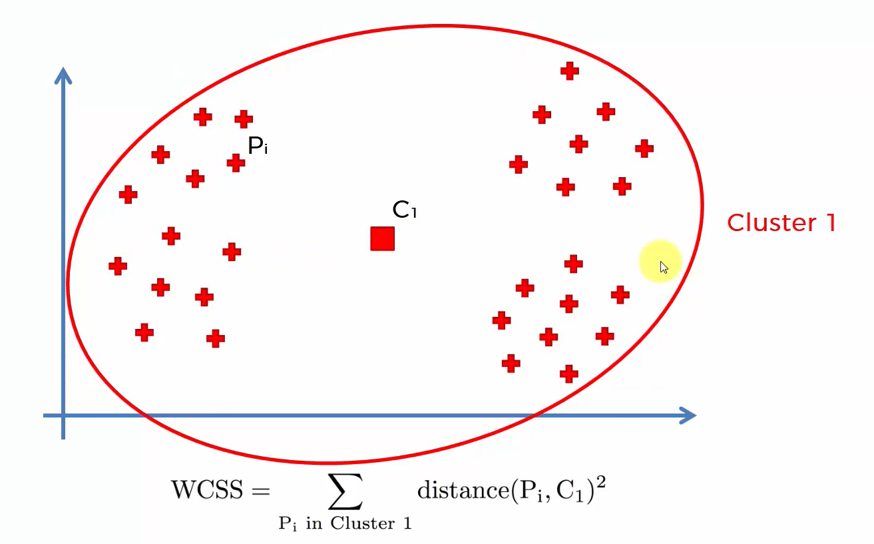
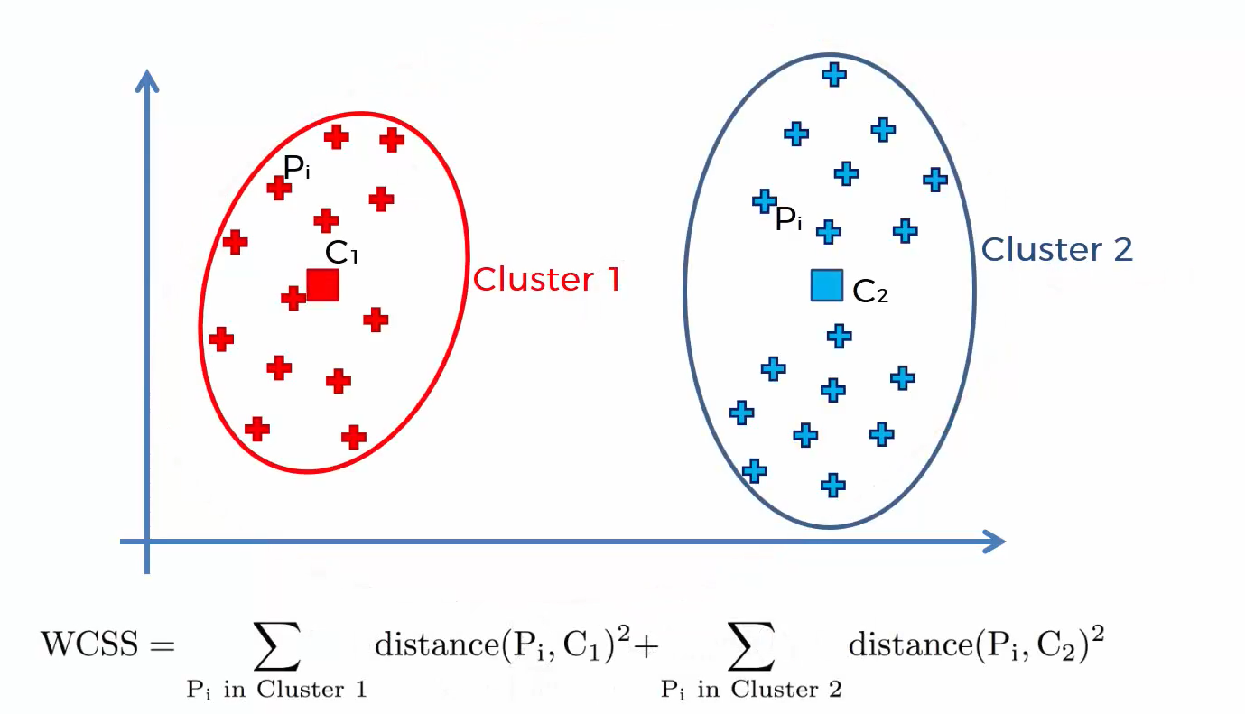
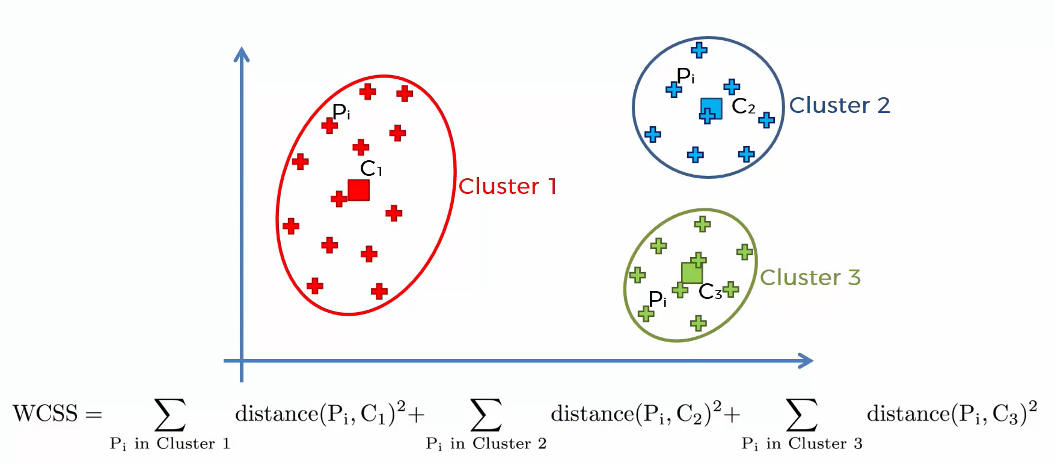
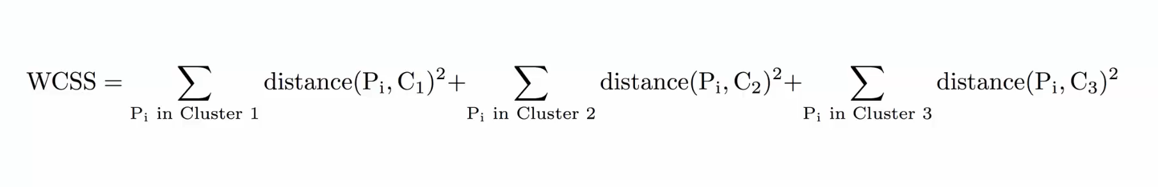
Selecting the number of clusters in K-Means
For the previous example we had something that could be defined as follows:
Solution: The Elbow Method
WCSS: Within Cluster Sum of Squares
P: Point
C: Cluster

Slide 9
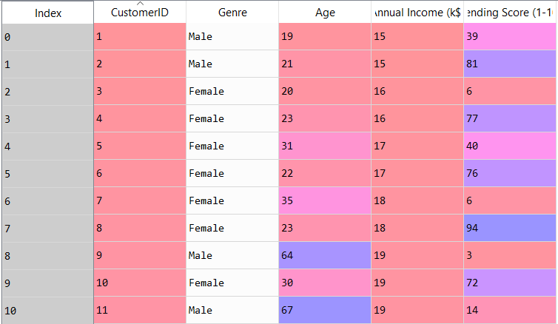
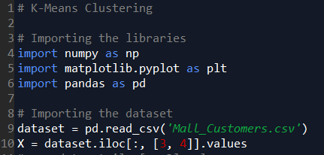
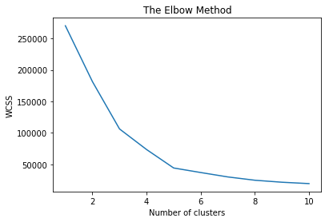
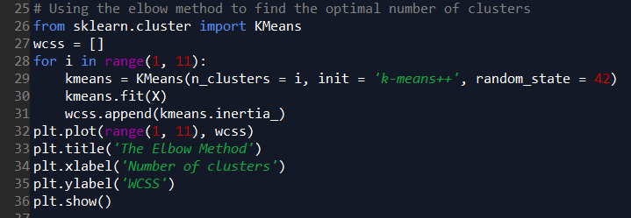
K-Means in Python

Slide 10
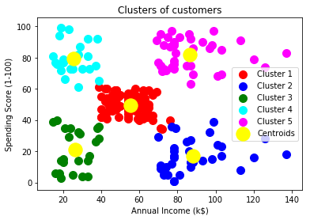
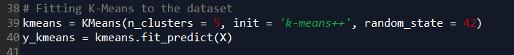
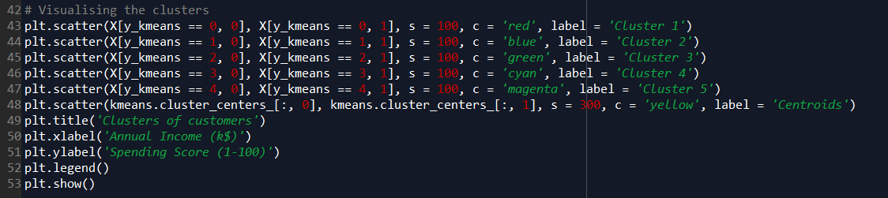
K-Means in Python

Slide 11
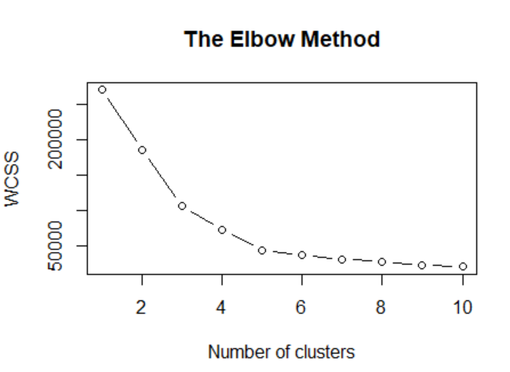
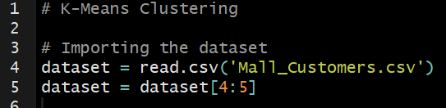
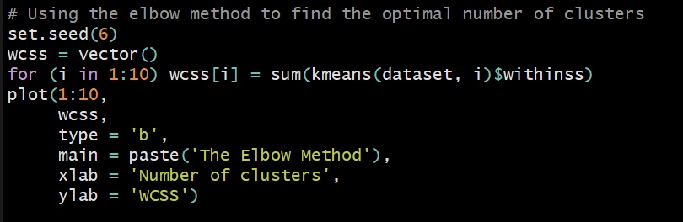
K-Means in R

Slide 12
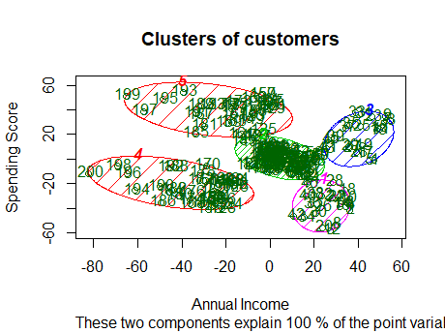
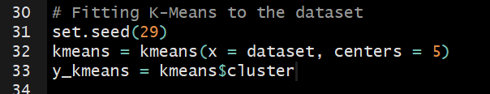
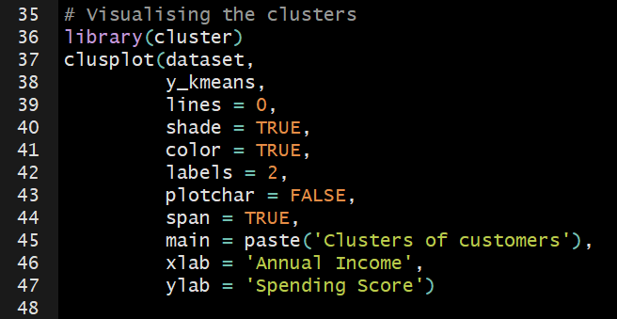
K-Means in R

Slide 13
K-Means Quiz
Let’s do a Quick Quiz
About K-Means Clustering

Slide 14
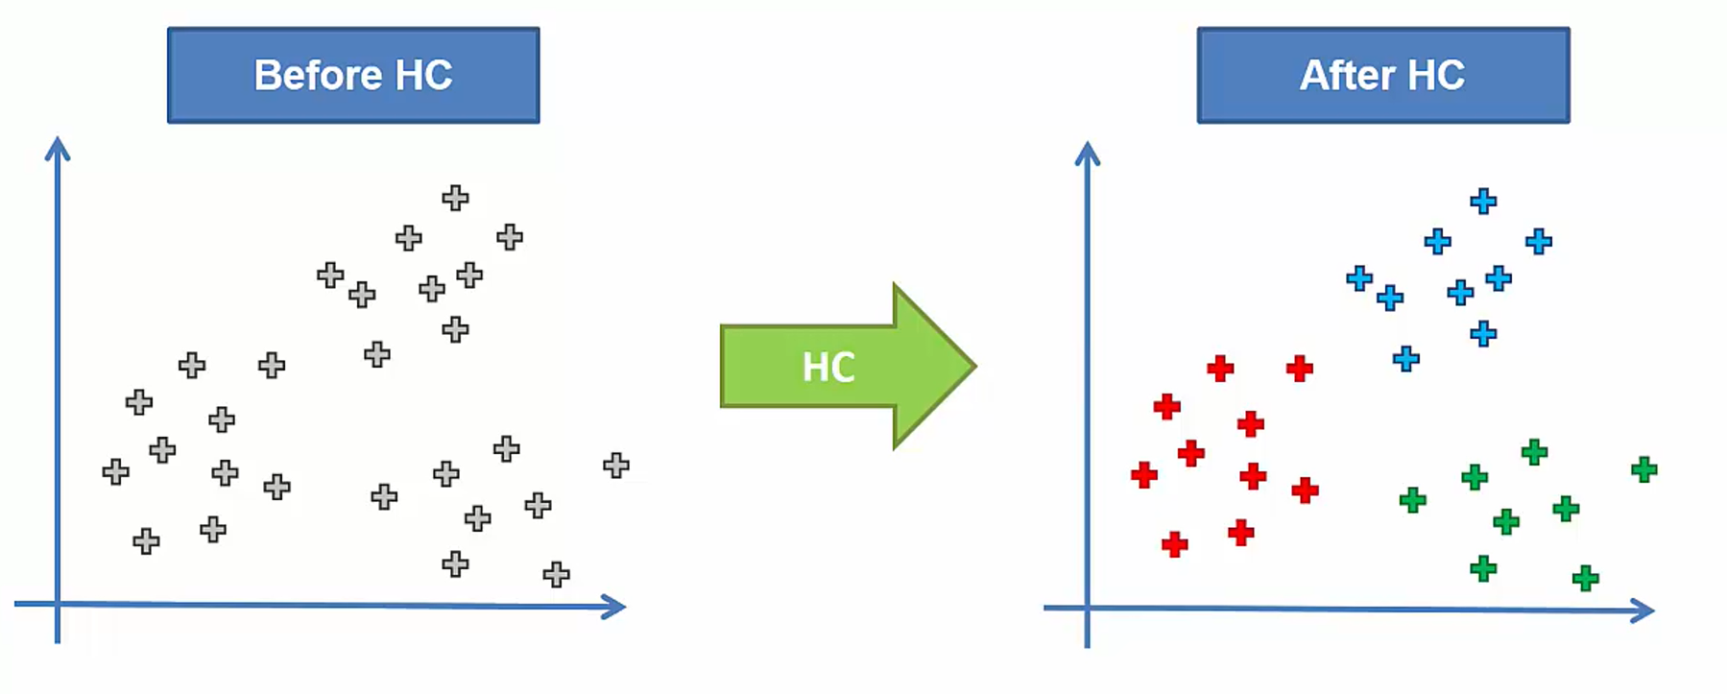
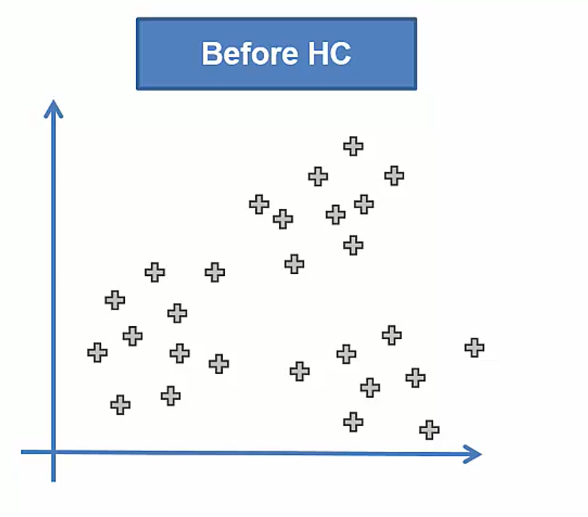
Hierarchical Clustering

Slide 15
Hierarchical Clustering
There are two types:
Agglomerative (and Divisive)
One is the opposite of the other
1
Make each data point a single-point cluster (forming N clusters)
2
Take the two closest data points and make them one cluster (N-1 clusters)
3
Take the two closest clusters and make them one cluster (N-2 clusters)
4
Let’s see this in the whiteboard
Repeat step three until there is only one cluster

Slide 16
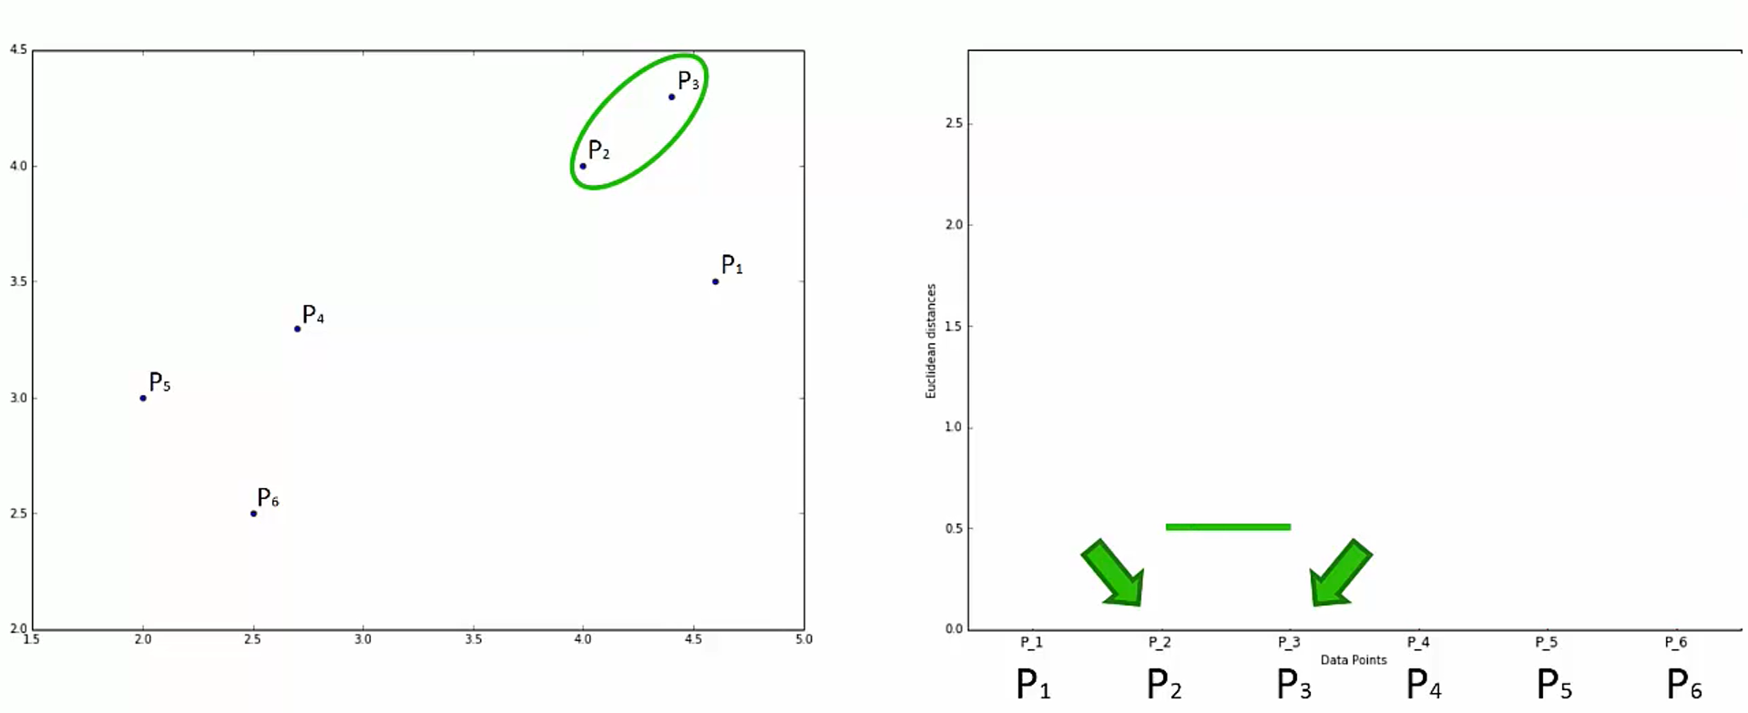
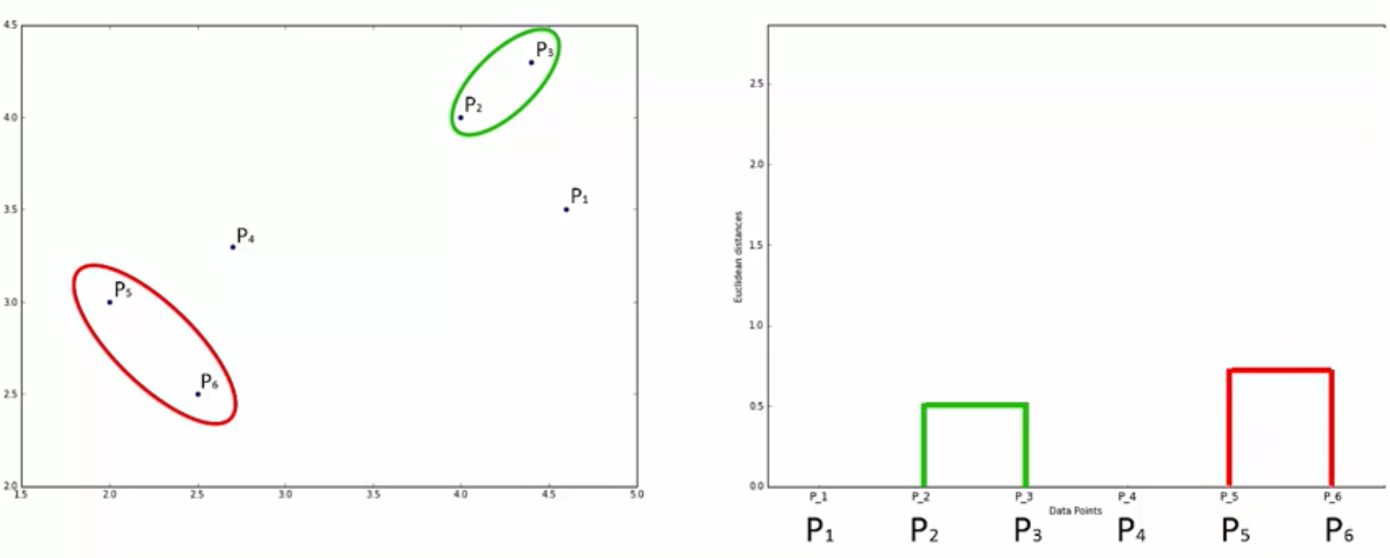
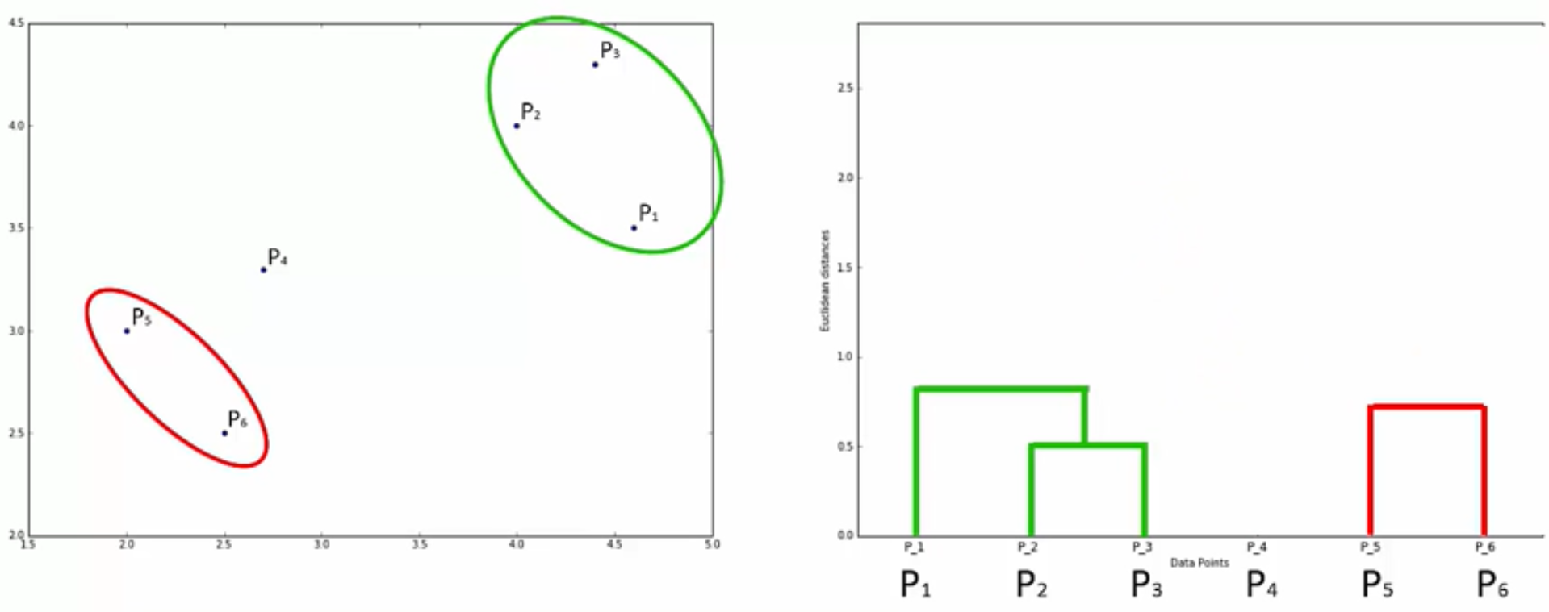
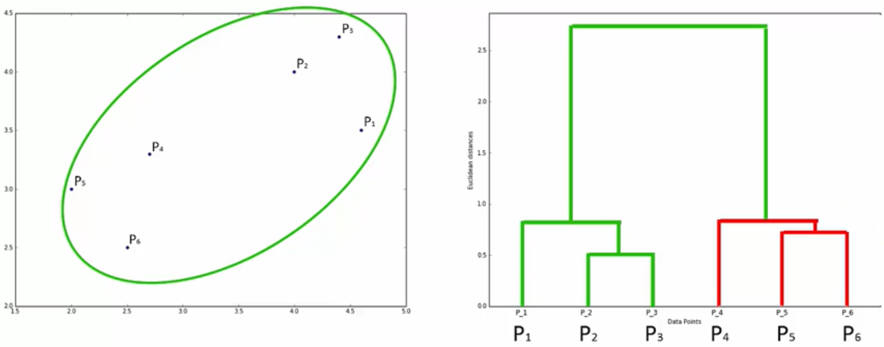
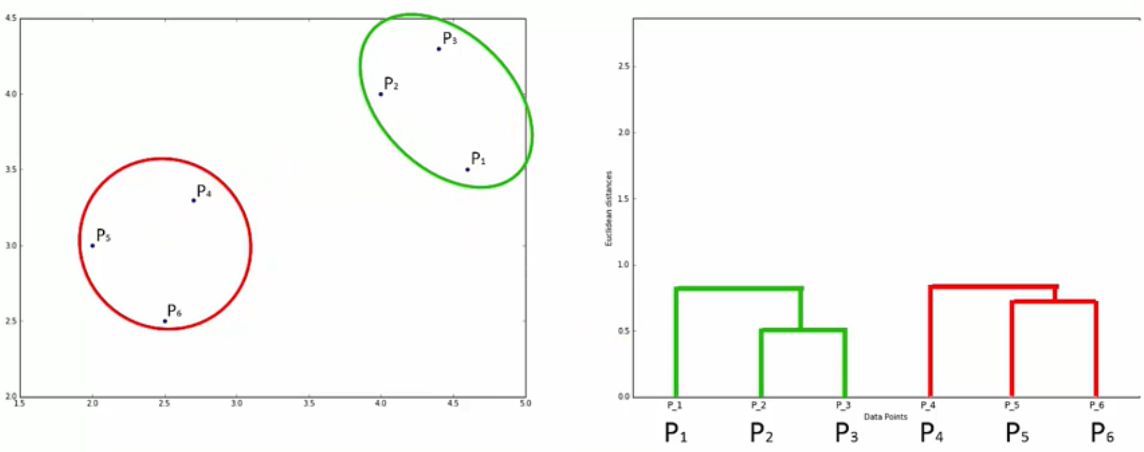
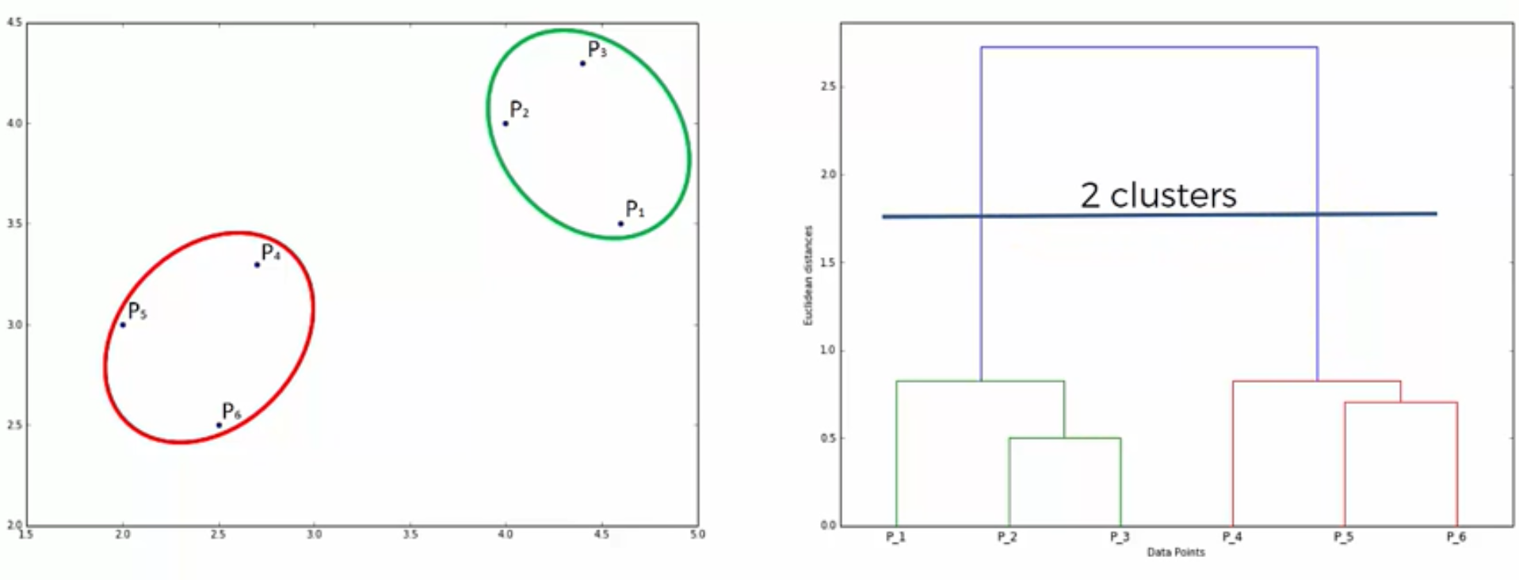
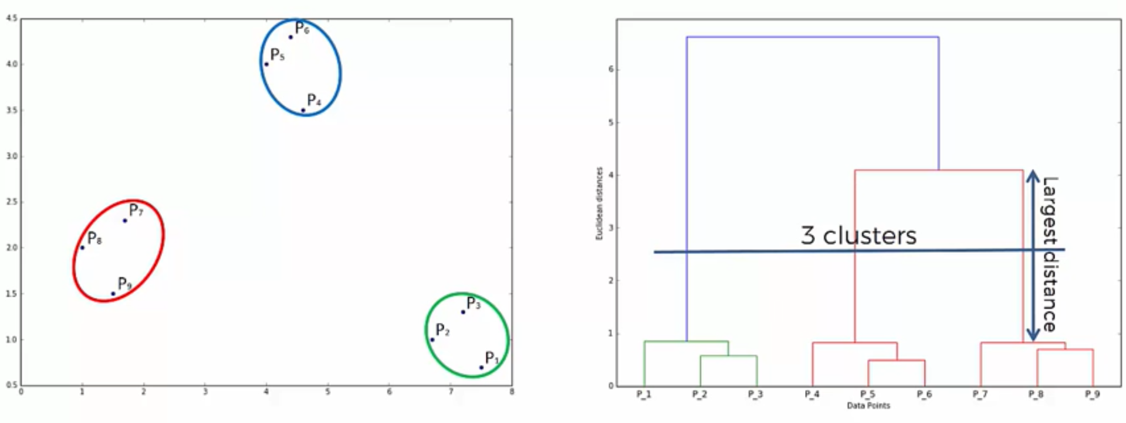
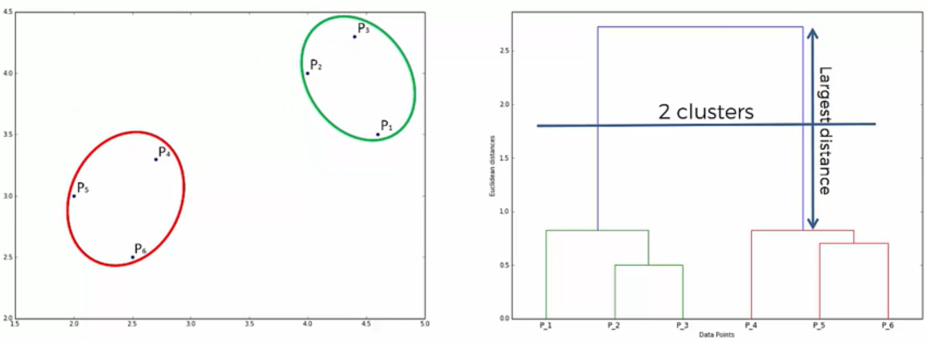
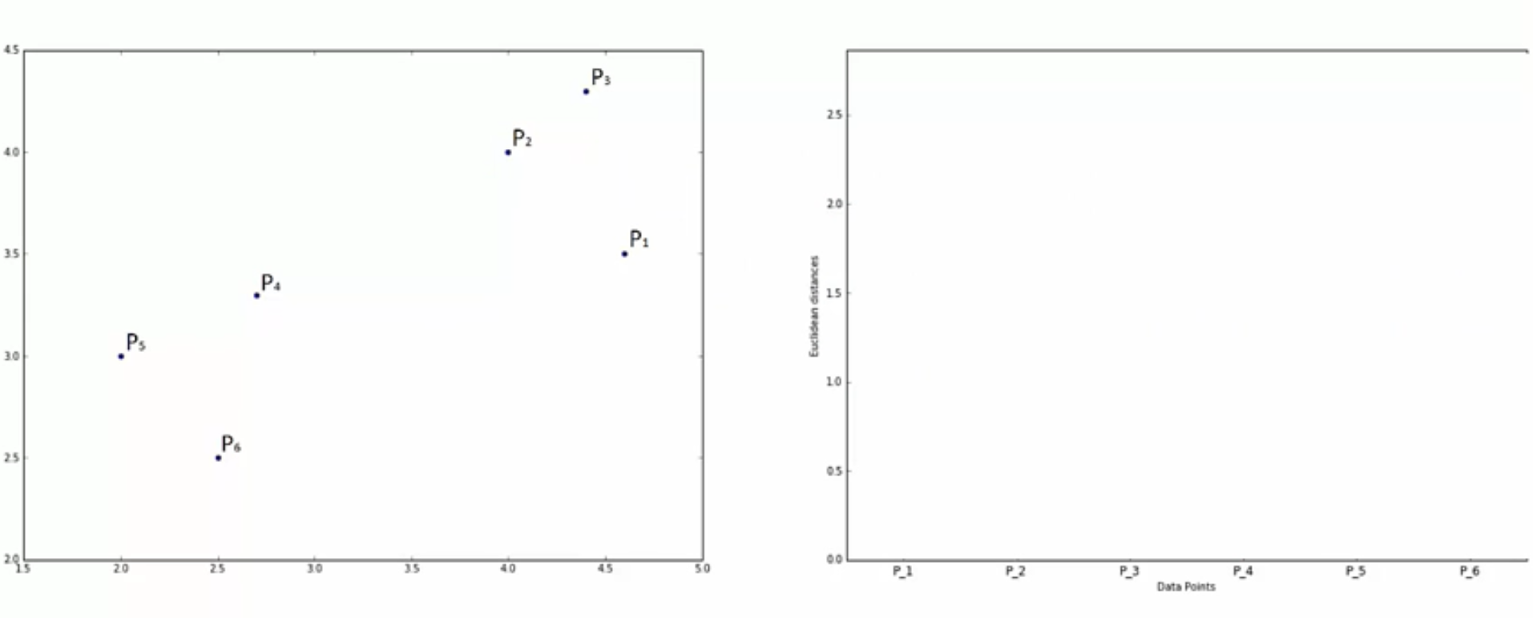
Dendograms
And how do they work
Remember: The highness represents the dissimilarity

Slide 17
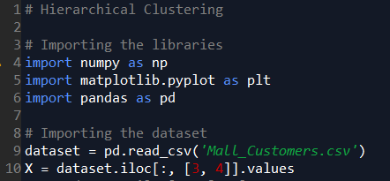
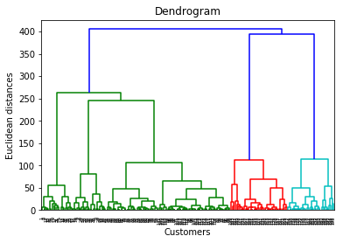
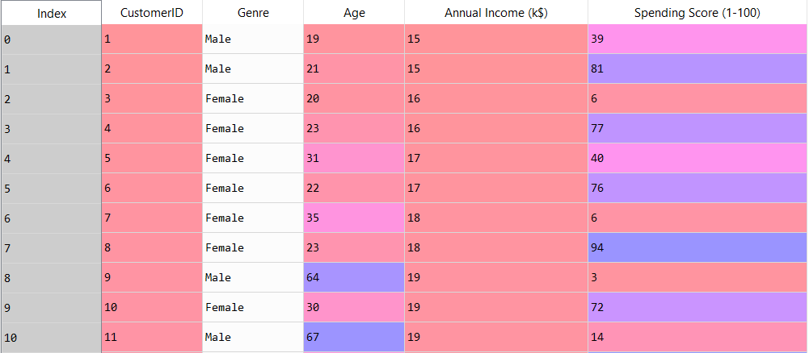
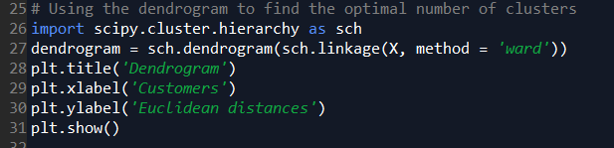
HC in Python
What is Ward?
Hint: Perform a similar job than WCSS

Slide 18
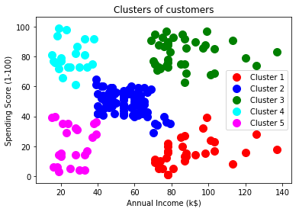
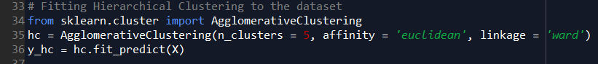

HC in Python

Slide 19



HC in R

Slide 20



HC in R

Slide 21
HC Quiz
Let’s do a Quick Quiz
About Hierarchical Clustering

Slide 22

Bonus: Clustering Cheat Sheet

Slide 23

Next Session:
Association
Rules
Thanks! Let’s make the complex simple…

Slide 24

Enjoy Machine Learning
;)

